Slide 1
Mount St. Helen’s
March 5th 2015
By: Claire Lemieux, Nicole Bena, and Erika Bout

Slide 2
What is Where?
May 18th, 1980
North Western America (Washington)
A Volcanic Eruption and Ash Cloud that covered much of North Western America

Slide 3
Location
Where It Is?
Ash Fallout
(Mount St Helens 1980 MEDC, 2014)
(Mt. Rainier: imminent threat to millions of Americans, 2013)

Slide 4
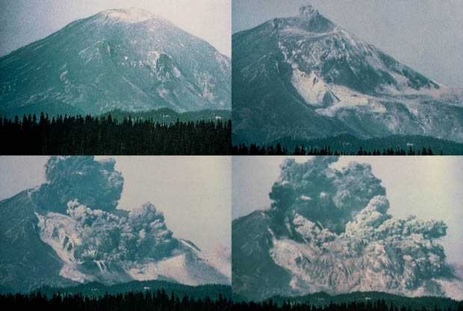
Why There?
Inside the magma chamber,
magma was building up
Eventually, the mountain
collapsed
Blowing out the entire side of the mountain
An enormous ash cloud
was produced

Slide 5
Video
https://www.youtube.com/watch?v=-H_HZVY1tT4

Slide 6
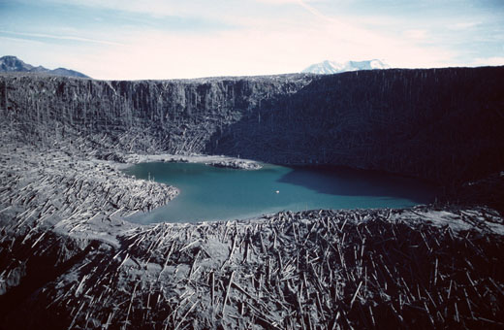
Spheres
Came from the Lithosphere
Effected the atmosphere, lithosphere, and biosphere

Slide 7
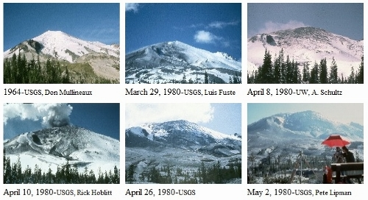
Lithosphere
The magma build up in the volcano was so great that the mountain was growing at a rate of 6.5ft per day! (1980 Cataclysmic Eruption, 2013)
This rapid growth and magma build up caused tremors (mini earthquakes) in and around the volcano

Slide 8
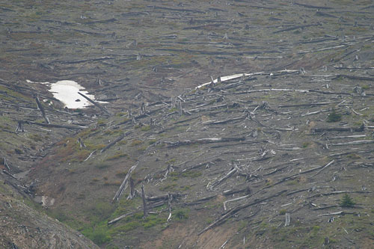
Lithosphere
Downwind of the volcano, many agricultural crops, such as wheat, apples, and potatoes were destroyed.
“The crusting of ash helped to retain soil moisture through the summer. In the long term, the ash may provide beneficial chemical nutrients to the soils of eastern Washington, which themselves were formed of older glacial deposits that contain a significant ash component.”
(Impact and aftermath, 1997)

Slide 9
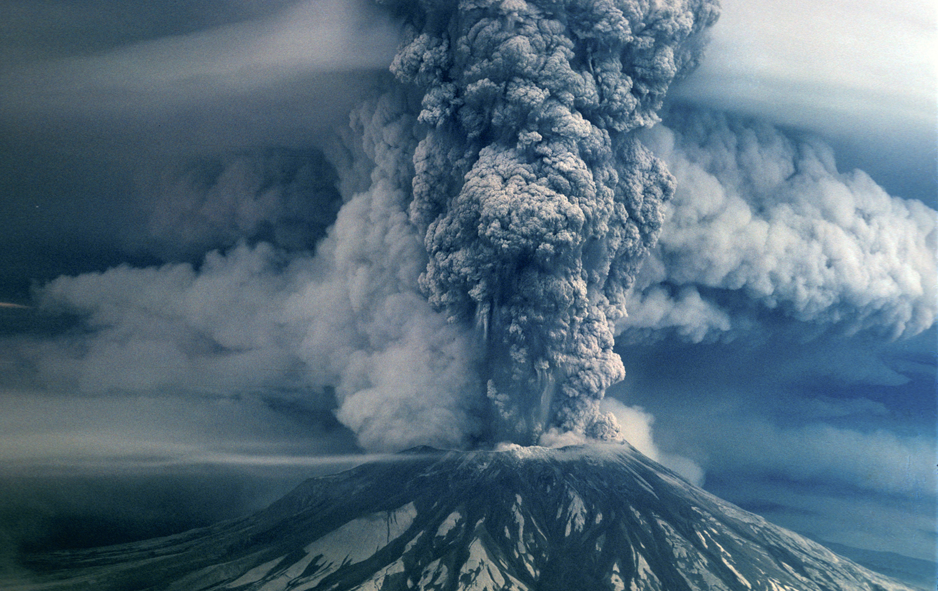
Atmosphere
The ash was so dense that over 1000 flights were cancelled due to poor visibility. (Impact and aftermath, 1997)
According to Gemma Purser, Mount St. Helens produced 0.01 gigatons of carbon dioxide during the eruption. (How much pollution does a volcano produce?, 2012)

Slide 10
Video
https://www.youtube.com/watch?v=AMxLBWAetfY

Slide 11
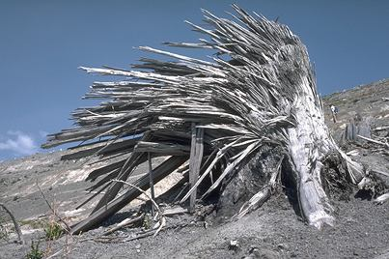
Biosphere
An estimated 11,000 Hares, 6 000 deer, 5 200 elk, 1 400 coyotes, 300 bobcats, 200 black bears, and 15 mountain lions died. (How do volcanos affect plants and animals?, n.d.)
57 people were killed
In an area 10km from the summit, virtually no trees remained of what was once a dense forest. (1980 cataclysmic eruption, 2013)

Slide 12
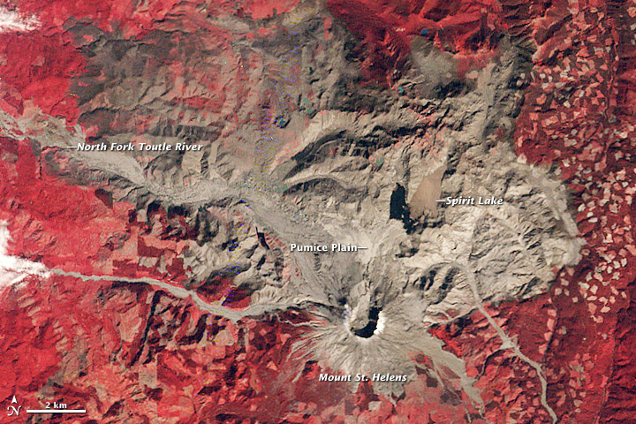
(Devestation and recovery from Mount St.Helens, N.D.)

Slide 13
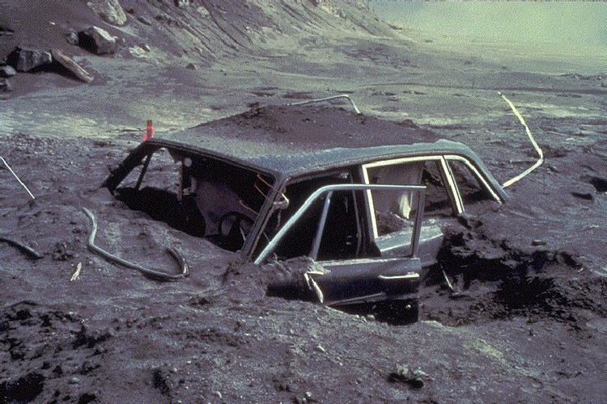
Why Care?
Hundreds people lost their jobs and homes
The eruption cost $1.1 billion
Residents reported suffering from stress and emotional problems
(Impact and aftermath, 1997)

Slide 14
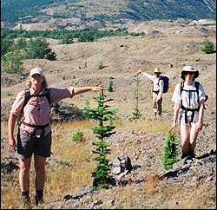
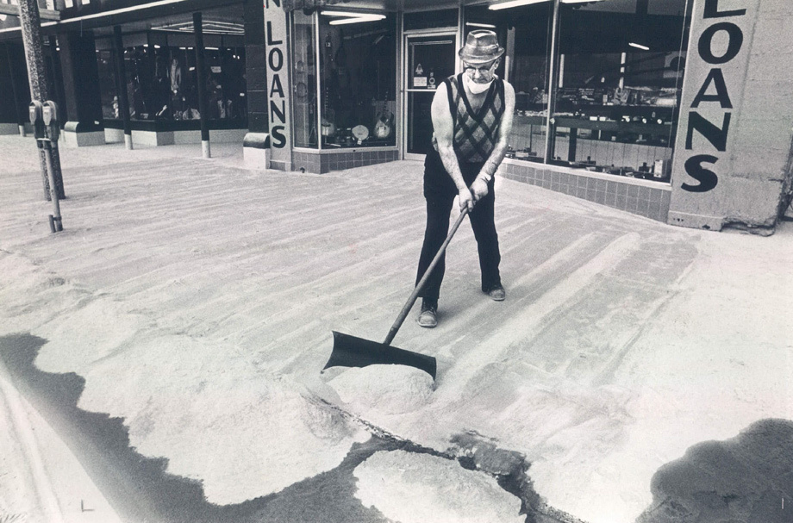
Short Term Aid
Rescuing people
Cleaning up the ash
Restore electricity
Give employment to those who are out of business because of the eruption
Long Term Aid
Millions of trees were replanted
A new highway was built
New tourist facilities were built (now 3 million people a year come to visit)
(Impact and aftermath, 1997)

Slide 15
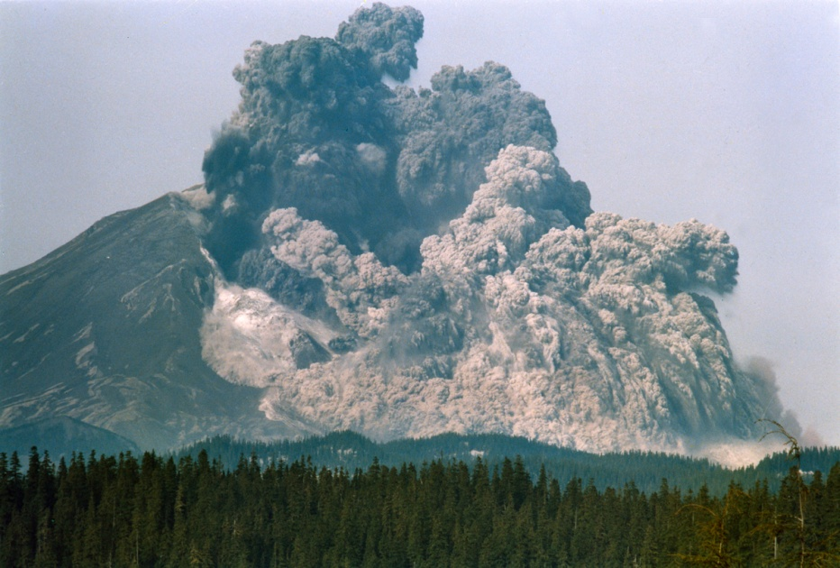
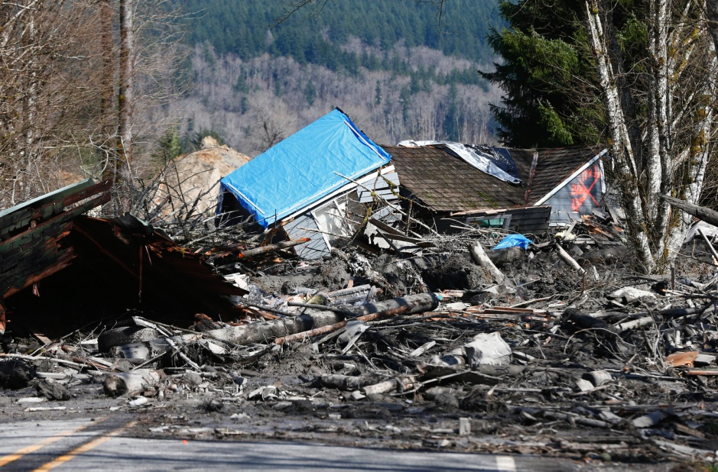
Conclusion
While the eruption origination from the lithosphere, it impacted the atmosphere, biosphere, and the lithosphere.
The lateral blast and the ash cloud was ultimately caused by magma build up in the magma chamber.
The 1980 eruption resulted in at least a billion dollars worth of damage, hundreds of people homeless and/or unemployed , and left many with emotional scars.

