Slide 1
MIDTERM REVIEW

Slide 2
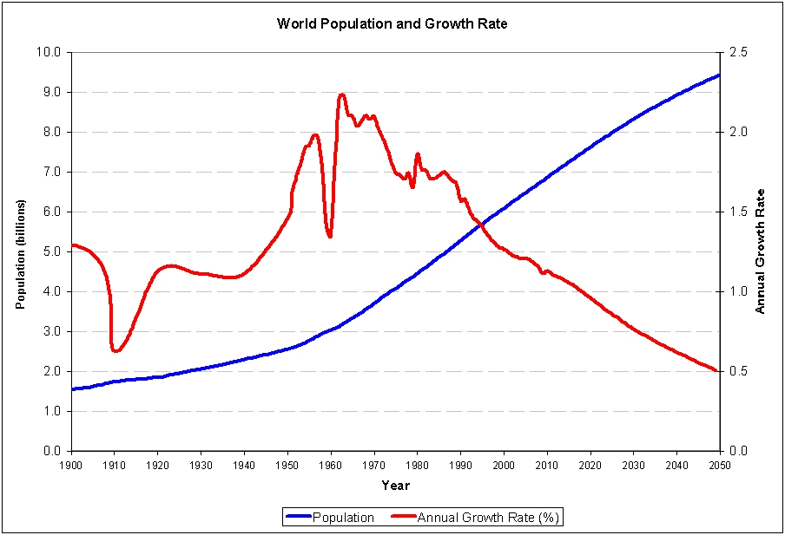

Slide 3
GLOBALLY
Population in the world is currently growing at a rate of around 1.14% per year.
The average population change is currently estimated at around 80 million per year
106 billion people have been born since the dawn of the human specie, making the population currently alive roughly 6% of all people who have ever lived on planet Earth.

Slide 4
WORLD POPULATION CLOCK
http://www.worldometers.info/world-population/

Slide 5
Canada's current annual population growth rate is 1.238%, or a daily increase of 1,137 individuals.
Canada had the highest net migration rate (0.61%) of all G8 member countries between 1994 and 2004.
Natural Increase (BR-DR) accounts for an annual increase of at a yearly rate of 0.413%.
Population in the world is currently growing at a rate of around 1.14% per year
Do you see something ‘funny’ here?

Slide 6
Birth Rates
World BR 19.15 births/1,000
Canada BR 10.28 births/1,000
Niger BR 51.60 births/1000 all top 10 in Africa
Japan BR 7.6 births/1000

Slide 7
Fertility Rate
World Fertility Rate: 2.41 births per woman
Canada Fertility Rate: 1.63 births per woman
India Fertility Rate: 2.59 births per woman
Niger Fertility Rate: 7.68 births per woman
Singapore FertilityRate: 1.07 births per woman

Slide 8
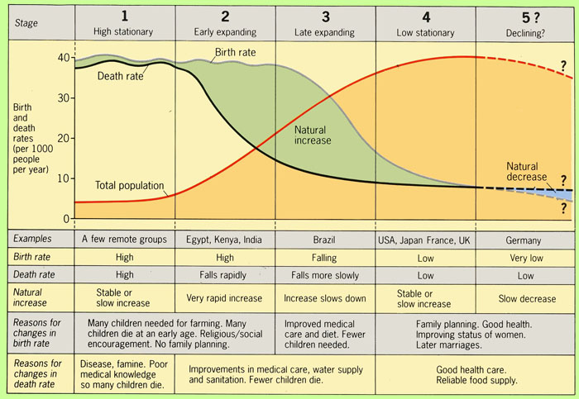

Slide 9
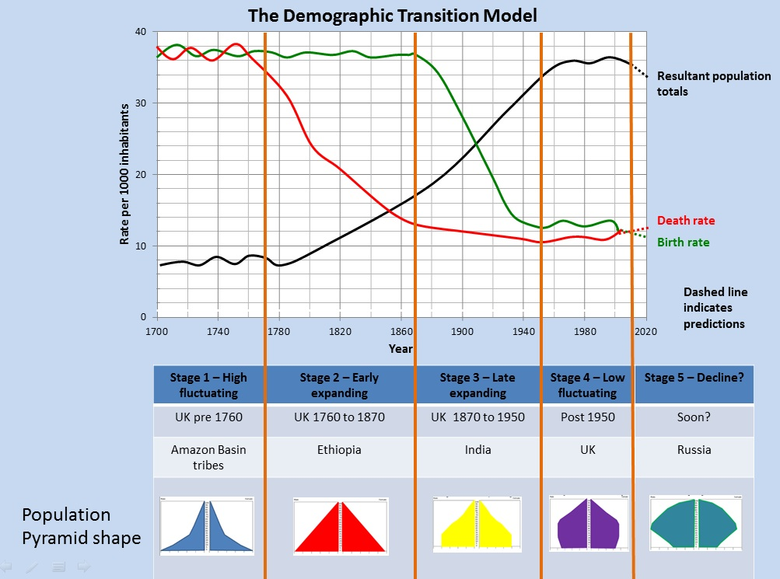
Demographic
Trap

Slide 10
Depenency load
55
25

Slide 11
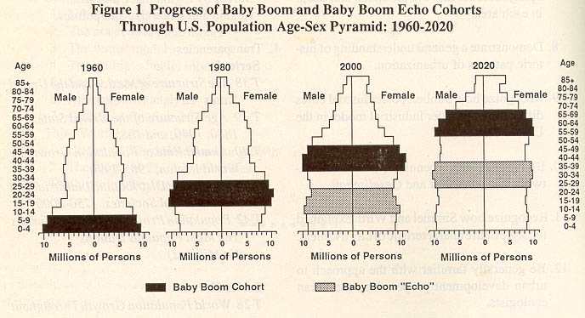
Boom and echo

Slide 12
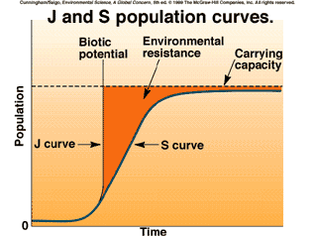
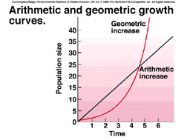
Population theories: optimistic
Bogue
Cornucopians

Slide 13
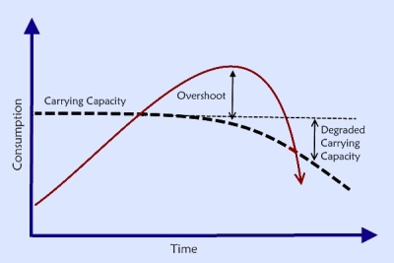
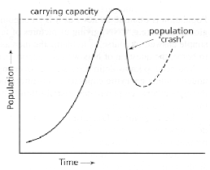
Population theories - pessimists
Thomas Malthus “Malthusian Predictions”
Catton –

Slide 14
Phantom carrying capacity
By using fossil fuels we are living in an ‘overshoot’ position.
This essentially is using 300 million years of solar energy stored in the earth (as oil, coal, nat. gas) and depleting it in 200 years of use.
Using this has increased our crop yields and mechanized our agriculture – all part of the green revolution that saw agricultural yields spike upwards in the 1960’s to present day.

Slide 15
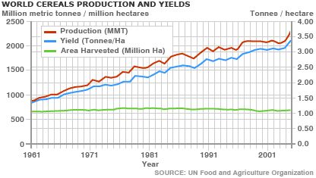
Phantom overshoot - Agriculture

Slide 16
