Slide 1
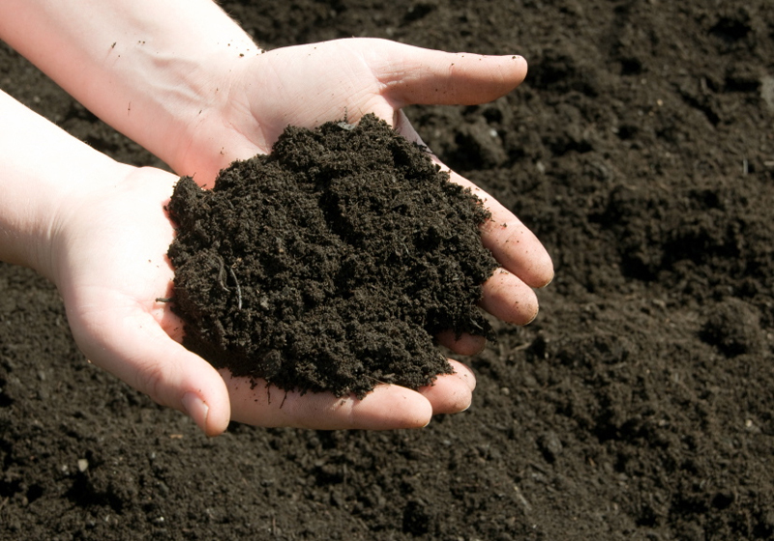
Our Soils
CGR 4MI

Slide 2
What is Soil?
To the engineer, soil is a foundation to build.
To the ecologist, soil supports and connects ecosystems.
To the archaeologist, soil holds clues to past cultures.
To craftspeople, like potters, soil provides clay to make things.
To the soil scientist, soil is all of these things.
Soil has been called “the skin of the earth” because it is the thin outermost layer of the Earth’s crust.
Like our own skin, we can’t live without soil.
Department of Natural Resources and Mines

Slide 3
Soil Ingredients
Soil is made of 5 components
Mineral matter (weather rock material)
Organic materials (humus), consists of decaying plant and animals matter
Air
Moisture
Living organisms including bacteria, fungi, worms and other decomposers

Slide 4
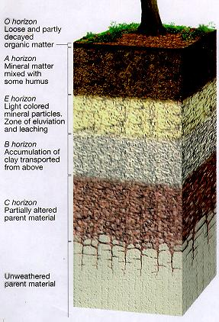
Soil Profiles
Humus: is a sticky brown residue of decomposing bodies of dead plants and animals
It gives the soil “structure” as it coats mineral particles giving it a spongy texture that holds water and nutrients – essential for plant life

Slide 5
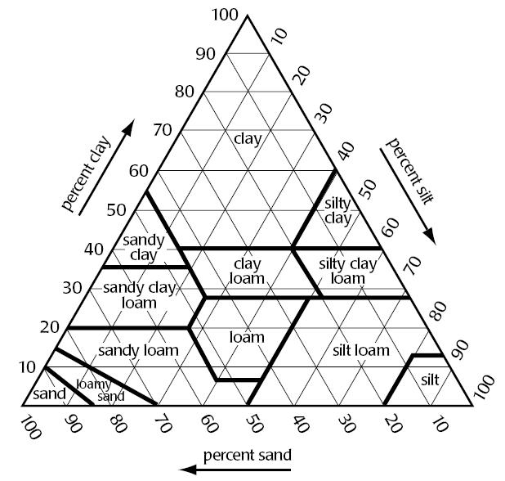
Sand, Silt, Clay and Everything In between

Slide 6
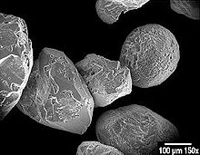
Sand
Grains of sand using an electron microscope
Range in size from 1/16mm to 2 mm
Most sand in S. Ontario is eroded limestone from the Niagara Escarpment
Considered “light soils” as sandy soils are cultivated easily
Sandy soils are ideal for tobacco, peanuts and market gardening cultivation due to its excellent drainage characteristics.
Erodes easily by wind or rain as water penetrates easily

Slide 7
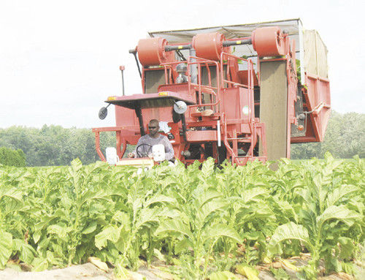
Picking tobacco near Simcoe, On

Slide 8
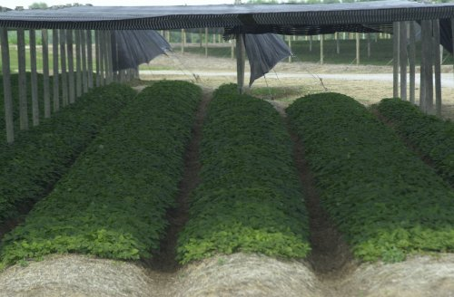
And Ginseng

Slide 9
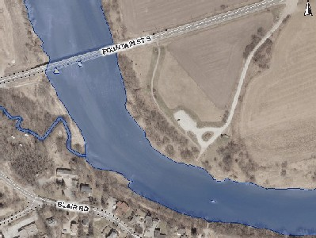
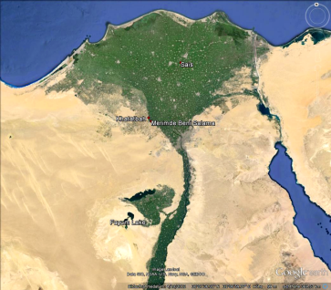
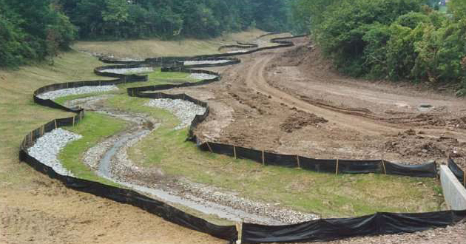
Silt
0.002 – 0.05 mm in particle size
Mainly eroded sand particles that have been transported and deposited by running or flooding water
Very fertile soil as during floods, silt is deposited leaving nutrients carried down stream by the river
Grand River, Nile River
Delta – very fertile
agriculture
areas

Slide 10
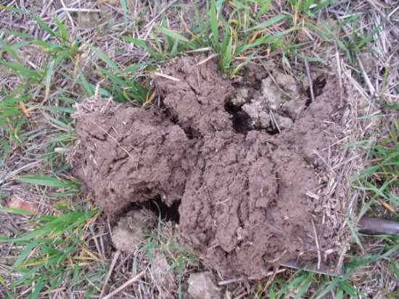
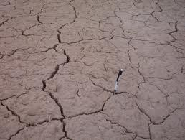
Clay
Less than 0.002 mm
Very fertile because it holds nutrients and moisture very well
When wet, gets very sticky and hard to cultivate
Excellent for growing grasses when conditions are suitable
During drought, clay soils turn to concrete

Slide 11
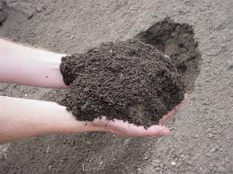
Loams
A mixture of both sand, silt, clay and organic matter
Can be sandy loam, clay loam, etc
the best kind of soil for plants as they drain well (sand) and allow for air movement yet hold
nutrients (clay)

Slide 12
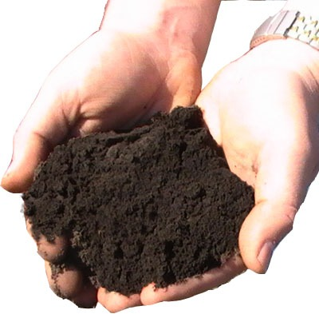
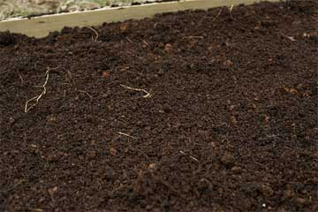
Good luck with your Greenhouse Projects!

