Slide 1
Global Terrorism

Slide 2
PART I : THE BASICS
What is it?
What types or terrorism?
Where does it come from?
Why is it used?
How can we prevent it?
What do we fear about Terrorism?

Slide 3
QUESTIONS
What is a definition?
History?
Purpose?
Perspective?
What terrorism isn’t?

Slide 4
DEFINITION
Is an unlawful act of violence
Intimidates governments or societies
Goal is to achieve political, religious or ideological objectives

Slide 5
PERSPECTIVE
Terrorism is different from regular crime because of its strong political properties
The definition of terrorism can vary from people to people due to the differences in standpoint
One person’s terrorist can be another’s freedom fighter

Slide 6
PERSPECTIVE
Those labeled "terrorists" by their opponents rarely identify themselves as such, and typically use other terms or terms specific to their situation, such as:
SEPARATIST INSURGENTS
FREEDOM FIGHTER LIBERATOR
REVOLUTIONARY VIGILANTE
PARAMILITRY GUERRILLA
REBEL PATRIOT JIHADI

Slide 7
PURPOSE
Terrorism is a political act designed by groups to have their message heard.
In other words…
It is a form of communication.

Slide 8
HISTORY OF TERRORISM
The term “terrorism” was coined in the French Revolution’s Reign of Terror (1793 – 1794). .
This was the birth of Government-Sponsored Terrorism
The line between terrorism and political violence is often blurred

Slide 9
Terrorism is Asymmetric Warfare.
Asymmetric warfare is the use of apparently random/unpredictable violence by an weak military against a stronger military to gain advantage. (Allen, 1997).
The key of Asymmetric warfare is using unexpected, unconventional tactics in combat (Craig, 1998).

Slide 10
CATEGORIES BY SPONSOR
Non-state Groups example: Al Qeda
Groups not part of the state apparatus of in opposition to the state are most commonly referred to as a "terrorist" in the media.
State Sponsors: example:
Hezbollah sponsored by Iran operating in Lebanon
Hamas sponsored by Iran operating in Israel
A state can sponsor terrorism by funding or harboring a terrorist organization. When states provide funding for groups considered by some to be terrorist, they rarely acknowledge them as such.
State Terrorism: example: Argentina’s ‘Dirty War’ in 1970’s
Argentina’s rightwing government systematically abducted tortured and killed left wing (communist) dissidents and protestors. Very secretive

Slide 11
TYPES OF TERRORISM
NATIONALISTIC: ACTS AGAINST A NATION –SEPARATIST AND OFTEN HAVE HEADQUARTERS IN ANOTHER COUNTRY –EX: IRA
REVOULUTIONARY- TO DESTROY THEIR OWN GOVERNMENT FROM WITHIN THEIR COUNTRY
RELIGIOUS / IDEOLOGICAL : BASED ON GLOBAL MEMBERSHIP - JIHAD
ACTS OF TERRORISM
DISRUPTIVE: TO DISRUPT AND DRAW ATTENTION TO CAUSE – INCREASE PRESTIGE (INTERNATIONAL)
COERCIVE: TO DEMORALIZE CIVILIAN COOPERATE(LOCAL)

Slide 12
CONCLUSIONS
Terrorism is an ancient tactic.
Terrorism is a mode of communication.
Terrorism is a special type of violence and Asymmetrical warfare.
Terrorism is used in times of peace, conflicts and war.
Terrorism is designed to make a point, through psychological means, fear.
Terrorism is a political act.

Slide 13
GUERILLA VS. TERRORISM
.
 | GUERILLA | TERRORISM
TARGETS | Mostly military, police, or political opponents | State symbols, political opponents, and the public at large
INTENDED IMPACTS | Mainly physical attrition of the enemy | Psychological coercion
TACTICS | Commando-type operations | Specialized tactics: kidnapping, car bombs, hijacking, etc.
LEGALITY | YES if following rules Of war | NO

Slide 14
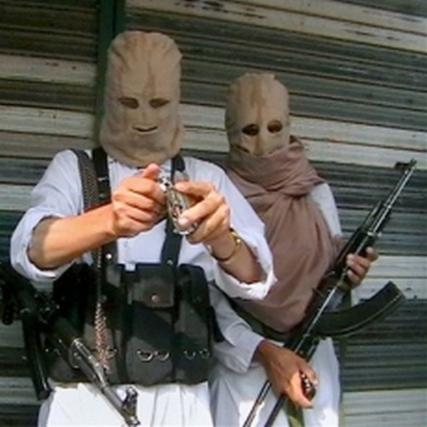
PART II TERRORISM TODAY

Slide 15
JIHAD
Jihad is used to refer to the modern day (2000’s) political militaristic conflict between Islamic fundamentalism and the West.
What is fundamentalism?
Koran interpretations that typically have intolerance to western values and in many cases women’s rights.
Living by Sharia Law and codes are politically integrated into

Slide 16
WHY DO WE HAVE THIS TYPE OF GLOBAL CONFLICT?
Origins in Western Colonialism by European Powers over Middle East territories with deeper roots in the Crusades during the Middle Ages between European Christians and Middle Eastern Muslims.
Today it is a complicated struggle.
Struggle against Western liberal values championed by the United States, popular culture, and the media.
Struggle against the capitalistic and militaristic imperialism of Western economies and multi national companies - ‘Globalization’
Struggle against the U.S. taking Middle Eastern Oil through corrupt and oppressive regimes – Saudi Arabians.
Struggle against Israel (Jewish and backed by U.S.) in the oppression of the Palestinians (Arab and Muslim backed by Iran)

Slide 17
WHAT ARE THE JIHAD GOALS?
For ISIS:
It is the process of consolidating its power as a government within the Islamic Caliphate. (an Islamic transnational government of all Muslims concerned with affairs of state and religion lead by a Caliph – spiritual leader)
For Al Qeda:
Removing Islamic / Arab Countries current leadership. They are perceived as secular (not bound by Islamic religious rule), promoting corrupted forms of Islam, and guilty of permitting foreign (e.g. Americans) occupation;
Removing American military, as well as economic and cultural, influence from the Middle East and Islamic countries; weakening Israel, an American ally, is a corollary goal.

Slide 18
ISN’T THE ISLAMIC WORLD AT WAR WITH ONE ANOTHER …as well as the West?
Yes! And it is most visible in Iraq
There are two branches of Islam: Sunni and Shia
It is similar to two branches of Christianity: Protestants and Catholics
It is similar to tribal branches – Hutu vs. Tutsi in Rwanda
http://www.washingtonpost.com/blogs/worldviews/wp/2014/01/22/why-sunnis-and-shias-are-fighting-explained-in-two-minutes/

Slide 19
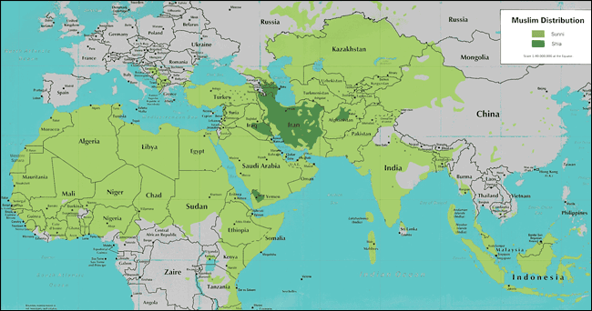
SUNNI 90% SHIA 10%

Slide 20
WHAT ABOUT IRAQ AND SYRIA?
In Iraq under Saddam Hussein the Sunnis (minority in Iraq) were given the best positions.
Today after the U.S. invasion and the removal of Hussein, Iraq is ‘controlled’ by the majority Shias (Shiites).
The civil war in Iraq and Syria then is Sunni rebel group ISIS trying to take over the Shia governments in Iraq and Syria.
The great irony here is that Shia Iran and the United States are fighting on the same side against ISIS and with Bashar al-Assad (also Shia) the Syrian leader who has been committing atrocities in his own country in a civil war sparked with the Arab Spring.
Arab Spring: Pan National uprisings across North Africa and the middle East to oust repressive dictators such as Gaddafi in Libya, Mubarak in Egypt, and Assad in Syria.. The others went… Assad hasn’t.

Slide 21
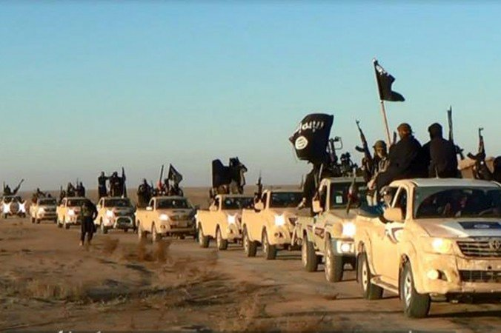
WHAT ABOUT IRAQ?
In Iraq under Saddam Hussein the Sunnis (minority in Iraq) were given the best positions.
Today after the U.S. invasion and the removal of Hussein, Iraq is ‘controlled’ by the majority Shias (Shiites).
The civil war in Iraq and Syria then is Sunni rebel group ISIS trying to take over the Shia governments in Iraq and Syria.
The great irony here is that Shi Iran and the United States are fighting on the same side against ISIS

Slide 22
WHY ISNT ISRAEL A TARGET?
Israel isn’t a target yet because ISIS wants Saudi Arabia…
The Middle East’s Sunni Powerhouse,
….home to Mecca,
….and the world’s largest exporter of oil!!
The Problem is:
Saudi Arabia is a U.S. ally and is therefore supported by U.S. oil interests which upset Osama bin Laden / Al Qeda in the first place (origins of Jihad!)
The ruthless Saudi Monarchy (dictatorship) has oppressed the Saudi people and is worried about it’s own internal insurgency (revolutionary terrorism).
Many private Saudi Sunnis sympathize, finance the ISIS action.
(state sponsored terrorism)
This worries the pro-U.S. Saudi monarchy so they upgrade militarily and clamp down on human rights.

Slide 23
HOW DOES ISRAEL, THE PALESTINIANS AND THE U.S. FIT IN TO THIS?
When Israel was created at the end of WWII it was championed by the United States.
Unfortunately Israel was created by plunking it right on top of Palestine therefore taking away their country and their land.
Palestinians are Arabs and Muslims.
The Palestinians have been fighting for their own country and land ever since.

Slide 24
ISLAMIC WORLD GLOBALLY
1.8 billion is Muslim
2.2 billion Christian
1.1 billion Secular
1 billion Hindu
The fastest growing religion due to reproduction rates and conversions.

Slide 25
MIGRATION TO EUROPE
Muslims are migrating into European countries to replace low fertility rates – the birth dearth. They are bringing their fundamental beliefs with them.
Now we can see a clash between liberal Western Media
(Charlie Hebdo) and its depiction of the Prophet Mohamed against these fundamentalist views of Muslims.
Economically many Muslims in Europe are poor, marginalized socially with higher unemployment and easy targets for Jihadi causes…
‘Jihad Cool’ is a method of recruitment here.

Slide 26
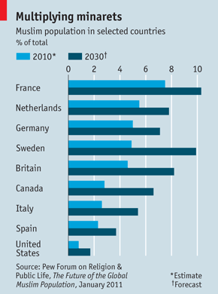
FUTURE POPULATIONS
They are also having much larger families than Europeans and therefore are seen as a threat to European cultures as their percentages rise and Europeans drop.
This will give them stronger voting rights
to determine the laws and cultures
of these democratic countries.
This adds more fuel to the fire….

Slide 27
CHARLIE HEBDO CARTOON
Does free speech give a publication the right to print, what they want…
Or is this provocation knowing that it is against Islam to show a picture of the Prophet Mohamed?

Slide 28
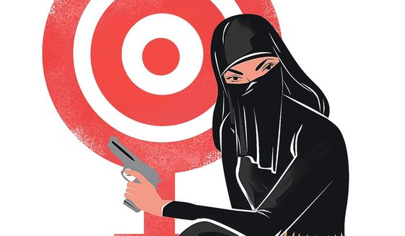
JIHAD COOL
Jihad Cool is a term used by Western security experts concerning the re-branding of militant Jihadism into something fashionable, or cool to younger people through social media, magazines, rap videos, clothing, toys, propaganda videos, and other means.
It is a sub-culture mainly applied to individuals in developed nations who are recruited to travel to conflict zones on Jihad.
For example Jihadi rap videos
make participants look
"more MTV than Mosque",

